Slide 1

Yandex Go Armenia
Ride-Hailing Market Intelligence Platform
Automated Data Collection, Relational Warehousing & Executive BI Analytics
Student / Author Edita Avetisyan
Lecturer / Supervisor Artyom Gasparyan
Institution
Ardy Academy
Academic Year 2026

Slide 2






Executive Summary
Market Challenge
Data Solution
Strategic Value
Ride-hailing pricing and availability fluctuate dynamically across locations and time periods. Accessing granular, historical market trends requires automated real-time observation.
An automated end-to-end data pipeline harvesting publicly observable estimates every 15 minutes, standardizing raw feeds into an enterprise MySQL data warehouse.
Delivers executive Power BI dashboards unlocking pricing patterns, peak demand surges, district heatmaps, and predictive pricing models for market intelligence.
Student: Edita Avetisyan | Lecturer: Artyom Gasparyan
Ardy Academy • 2026

Slide 3








Core Business Objectives
1. Automated Scraping
2. MySQL Warehouse
3. Star Schema Design
Build resilient Python & Playwright scrapers capturing fare estimates, ETAs, and surge rates from 50+ locations every 15 mins.
Architect a scalable relational warehouse storing thousands of time-series observations with full data integrity.
Develop optimized dimensional models with explicit Fact and Dimension tables for high-performance BI queries.
4. Python ETL Pipeline
5. Power BI Dashboards
6. Market Intelligence
Implement Pandas transformations for data cleaning, geo-tagging, missing value handling, and scheduled database ingestion.
Design a comprehensive multi-tab executive dashboard featuring advanced DAX metrics, interactive filters, and drill-downs.
Extract actionable business insights on surge pricing, airport premiums, district demand, and predictive fare modeling.
Student: Edita Avetisyan | Lecturer: Artyom Gasparyan
Ardy Academy • 2026

Slide 4
Key Research Questions
Dynamic Pricing Patterns: When are ride fares most expensive throughout the day and week, and what triggers surge pricing spikes?
Geographic & District Variance: Which pickup districts and inter-city routes exhibit the highest average fare per kilometer?
Traffic vs. ETA Correlations: How severely does peak traffic congestion impact Estimated Time of Arrival (ETA) across major urban hubs?
Ride Tier Value Comparison: How do Economy, Comfort, Comfort+, Minivan, and Business tiers compare in price, ETA, and availability?
Predictive Price Modeling: Can historical pricing and environmental variables be leveraged to accurately forecast future fare surges?
Student: Edita Avetisyan | Lecturer: Artyom Gasparyan
Ardy Academy • 2026

Slide 5



End-to-End Architecture
Yandex Go Web
Playwright
Python ETL
MySQL DB
Power BI
Public estimate API endpoint & pricing interface
Automated headless scraper running every 15 min
Pandas cleaning, parsing JSON & structured load
Star schema warehouse with fact & dim tables
Interactive executive dashboard & reporting
Student: Edita Avetisyan | Lecturer: Artyom Gasparyan
Ardy Academy • 2026

Slide 6


Data Engineering Specs
Automation & Scraping
Star Schema Warehouse
• Frequency: Cron-scheduled polling every 15 minutes across 50+ coordinate points in Armenia.
• Fact Table: FactRideEstimates containing metric values (fare, distance, ETA, surge index).
• Technology: Python 3.14 with Playwright async browser contexts for resilience.
• Dimension Tables: DimLocation, DimTime, DimDate, DimRideType, and DimWeather.
• Data Fields: Pickup/Dropoff coords, Fare (AMD), ETA (mins), Distance (km), Ride Tier, Surge Multiplier, and Timestamp.
• Optimization: Indexing on timestamp and location keys for sub-second DAX query execution.
Student: Edita Avetisyan | Lecturer: Artyom Gasparyan
Ardy Academy • 2026

Slide 7
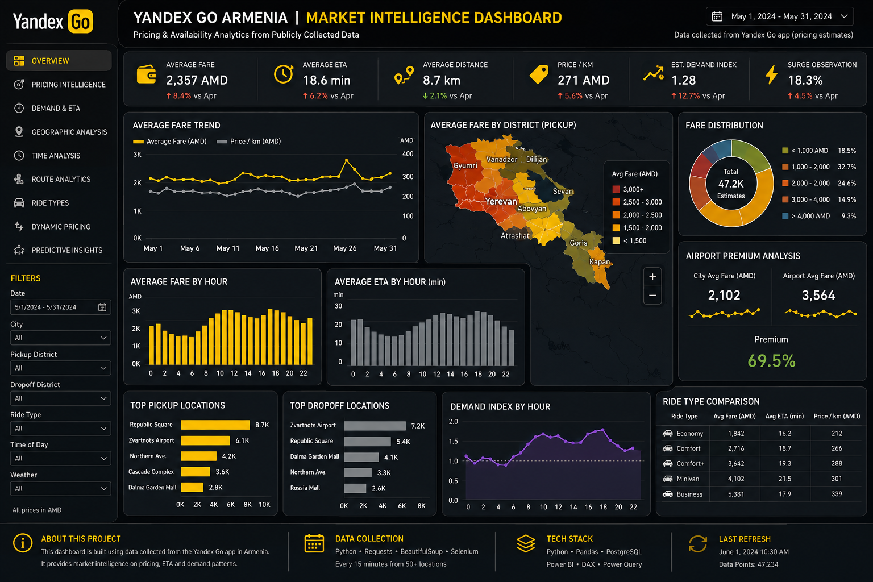

Power BI Dashboard & Report
Analytical Modules
1. Executive Overview: High-level KPIs & performance
2. Pricing Intelligence: District heatmaps & surge grids
3. Demand & ETA Analysis: ETA heatmaps & weather impact
4. Geographic Analysis: Map pricing across Armenia
5. Time Analysis: Hour/Day seasonality & trendlines
6. Route Analytics: Top origin-destination corridors
7. Ride Type Analysis: Tier breakdown (Economy vs Business)
8. Predictive Insights: Fare forecasting models
Student: Edita Avetisyan | Lecturer: Artyom Gasparyan
Ardy Academy • 2026

Slide 8








Implementation Roadmap
Phase 1: Scraping
Phase 2: Database
Phase 3: Business Intelligence
Phase 4: ML & Delivery
• Setup Playwright scripts
• Define location matrix
• JSON parser development
• 15-min automated cron
• MySQL schema setup
• Star Schema creation
• Index optimization
• Historical data backfill
• Predictive fare models
• Executive report
• Technical documentation
• GitHub repo release
• Power BI integration
• DAX measures setup
• Dashboard views
• Interactivity & filters
Student: Edita Avetisyan | Lecturer: Artyom Gasparyan
Ardy Academy • 2026

Slide 9

Expected Project Scope
Deliverable Component | Technical Stack | Key Output / Description
Automated Data Scraper | Python + Playwright | Headless automated browser pipeline extracting JSON pricing every 15 min.
Relational Data Warehouse | MySQL Engine | Star schema relational store with FactRideEstimates & 5 dimension tables.
Data Transformation Pipeline | Python + Pandas | Automated ETL script handling data validation, cleaning, and database loading.
Power BI Executive Suite | Power BI Desktop + DAX | Interactive 8-tab dashboard deck with real-time dynamic filters and heatmaps.
Project Portfolio & Docs | GitHub Repository | Complete source code, technical documentation, SQL scripts, and project writeup.
Student: Edita Avetisyan | Lecturer: Artyom Gasparyan
Ardy Academy • 2026

Slide 10


Questions & Discussion
Thank you for reviewing this project proposal!
GitHub Project Repository
github.com/edita-avetisyan
Student: Edita Avetisyan | Lecturer: Artyom Gasparyan | Ardy Academy (2026)
Capstone Project Proposal
Ardy Academy • 2026

